Slide 1
AusRetail SQL Project
Michael Le

Slide 2
Requirements
Install and Download SQL Server Express (2022,or 2025 (much preferred)) from Microsoft
Files and sources from my repository:
Main-Stuff/DA Bootcamp 2026 Emergi Mentors/Week 2 SQL Mastery/Module 2 SQL for Business Analytics Beginner Projects at main · Mikele02171/Main-Stuff

Slide 3
Business Questions
Which Stores do we have in Victoria?
List all premium products priced over $500
Transaction volume for December 3
Top-selling products this week?
Store Performance Dashboard

Slide 4
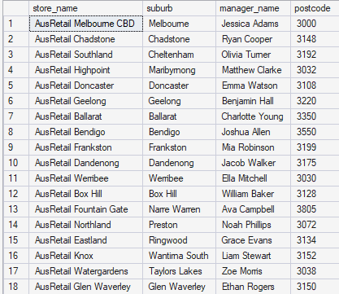
Which Stores do we have in Victoria?
SELECT
store_name,
suburb,
manager_name,
postcode
FROM stores
WHERE state = 'VIC';

Slide 5
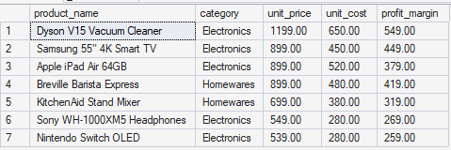
List all premium products priced over $500
SELECT
product_name,
category,
unit_price,
unit_cost,
(unit_price - unit_cost) AS profit_margin
FROM products
WHERE unit_price > 500
ORDER BY unit_price DESC;

Slide 6

Transaction volume for December 3
SELECT
COUNT(*) AS total_transactions,
SUM(amount) AS total_revenue,
AVG(amount) AS average_transaction_value
FROM transactions
WHERE transaction_date = '2024-12-03';

Slide 7
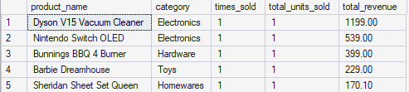
Top-selling products this week?
SELECT
p.product_name,
p.category,
COUNT(t.transaction_id) AS times_sold,
SUM(t.quantity) AS total_units_sold,
SUM(t.amount) AS total_revenue
FROM transactions t
JOIN products p ON t.product_id = p.product_id
WHERE t.transaction_date >= '2024-12-01' -- This week (Dec 1-7)
AND t.transaction_date < '2024-12-08'
GROUP BY p.product_name, p.category
ORDER BY total_revenue DESC;

Slide 8
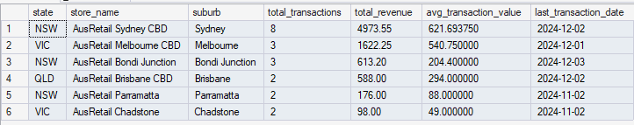
Store Performance Dashboard
SELECT
s.state,
s.store_name,
s.suburb,
COUNT(t.transaction_id) AS total_transactions,
SUM(t.amount) AS total_revenue,
AVG(t.amount) AS avg_transaction_value,
MAX(t.transaction_date) AS last_transaction_date
FROM stores s
LEFT JOIN transactions t ON s.store_id = t.store_id
WHERE t.transaction_date >= '2024-10-01' -- Q4 2024
AND t.transaction_date < '2025-01-01'
GROUP BY s.state, s.store_name, s.suburb
ORDER BY total_revenue DESC;

